Slide 1
Smart City The IOT Project

Slide 2
Group member’s details
NAME | ENROLLMENT
BASITA RONAK K. | 180163107002
CHAVDA DARSHAN R. | 180163107010
PATHAN MOHAMMAD RIYAZKHAN S. | 180163107027

Slide 3
Outlines:
Definition
Objective
Project Details
How It Works?
Similar Project and Their Limitation
Our Services
Social Impact
Economical Impact
Future Plan
References

Slide 4
DEFINITION
Normal City
In Normal cities people live their lives in bounded environment and do all the normal stuff of their lives manually by themselves or through others.
Generally, there is no automation for any worthless thing and people waste their precious time on the essence care of these small worthless things.
Smart City
In Smart Cities people live standard lives and do all the normal stuff with the help of latest technology trends like machineries, robotics and Information Technologies.
The people of the smart city can focus on their primary objective without taking burden of the worthless stuffs. All the daily normal task are done by the machines.

Slide 5
OBJECTIVE
The objective of “Smart City” Project is about automation of some places that are in the city like Parking system, Street light, Waste Management, Water Supply for home or public tanks to promote cities that provide core infrastructure and give a decent quality of life to its citizens, a clean and sustainable environment.

Slide 6
PROJECT Details
In “Smart City” project our team is just trying to manage different places of city with the help of some electronic devices, Information technology and IOT technology.
Modules of Project:
Smart Waste Management
Automatic Street Light
Smart Parking System
Smart Water System

Slide 7
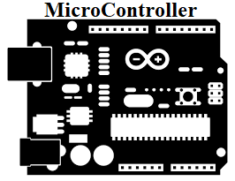
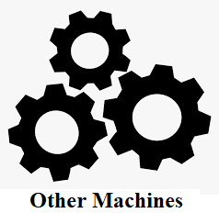
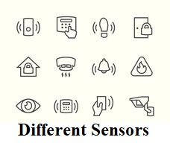



How It Works?
Environment
2
1
3
5
5
4

Slide 8
SIMILAR PROJECTS AND THEIR LIMITATION
Poor automation in Parking System
Zero automation in Waste System
Physical management of Street Light
Manual Municipal Water Supply system

Slide 9
Our services
Smart City Project provide following services
Smart Waste Management
Automatic Street Light
Smart Parking System
Smart Water System
Smart city Project will also provide Mobile Application and Website to the users of city to make them allow to observe the environment around them.

Slide 10
Smart waste management
How it works?
In smart waste management , if any particular area's dustbin is full then notification or message will be sent to the dumping station of government and through this message government worker can identify which dustbin is full in which area and they can do further process for cleaning that dustbin, Which can help to makes our city clean and gives clean environment.

Slide 11
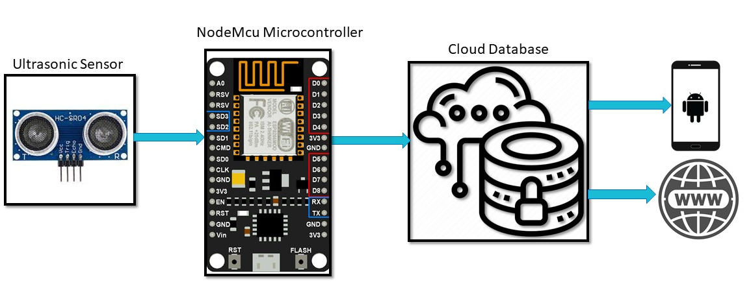
Block Diagram:-

Slide 12
Working

Slide 13
Automatic Street light
How it Works?
In Automatic Street Light System, If any movement is detected near by the street lights then the intensity of the lights will increased and if no movement nearby is detected then the intensity of the lights will remains low.
Through the low intensity of the Lights, Electricity can be saved upto some points.

Slide 14
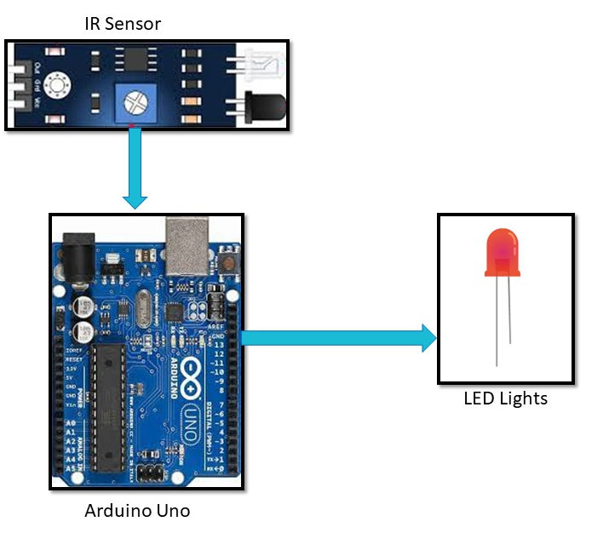
Block Diagram:-

Slide 15
Working

Slide 16
Smart parking system
How it Works?
In smart parking system, there is parking area in the city and if there is any free slot is available then only it will allow to enter new vehicle in the parking area and if it is full then it will not allow to enter in the parking area.
User can observe the status of that parking area through website and website gives real time data related to parking area.

Slide 17
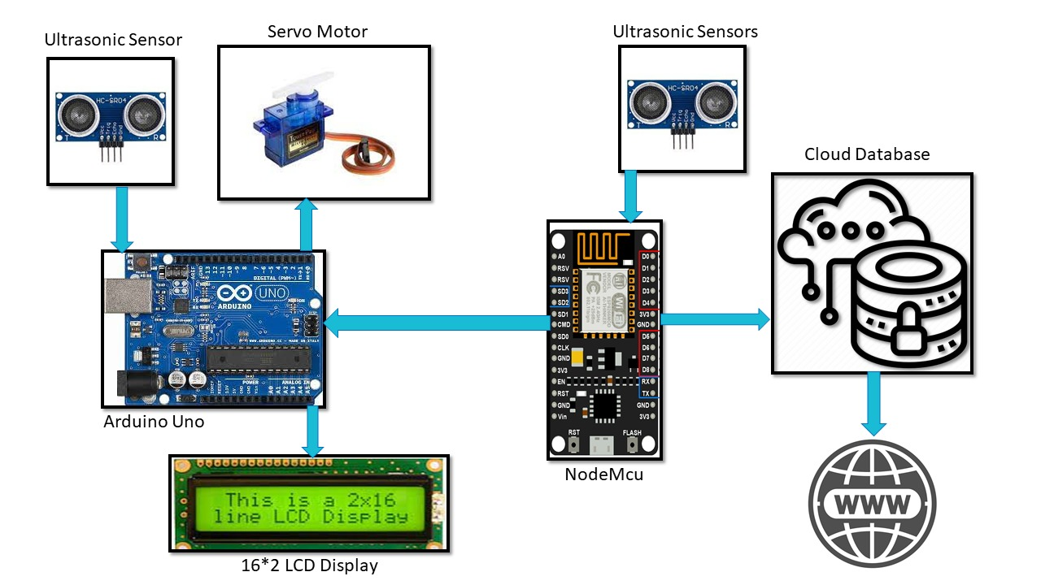
Block Diagram:-

Slide 18
Working

Slide 19
Smart water system
How it Works?
In smart water system, there is water tank in the city or society, if it is empty then the water pump will automatically turns on and remain on until water tank is full and when it is full then the water pump will automatically turns off.
There are some LED indicator which will show the water level in water tank.
The water level information and water pump status can also be seen through website by users.

Slide 20
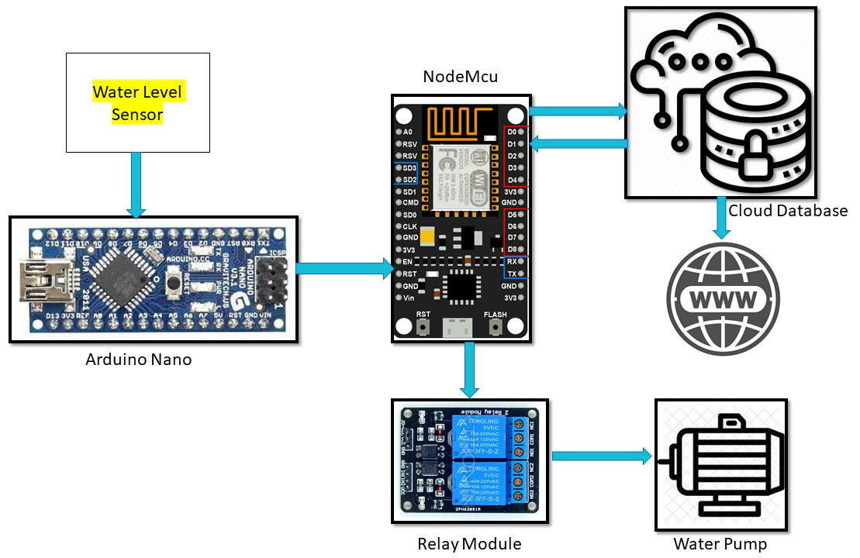

Block Diagram:-
WATER
LEVEL
SENSOR

Slide 21
Working

Slide 22
Social Impact
The Smart City project will give Quality life to the people of city and make their life more easy and convenient.
Using this project people can save their time, water, electricity and also make their city clean which helps to provide core infrastructure and gives decent quality of life to it's citizens, a clean and sustainable environment.

Slide 23
Economical impact
Automation brings cost saving with AI based and IOT technologies automating city resources such as water, electricity, and saving significant amount of money by doing so.
A sustainable ecosystem with reduced emission and cleaner city, greatly increase the standards of living, happiness and leads to economic growth.
Smart Cities are great investment that can impact the economy in a positive way.

Slide 24
Future Plan
As we know there is no limit that can include in the Smart City.
As we have completed primary modules we will going to add some module in the project like...
Traffic Management System,
Air Pollution Management,
Smart Irrigation System,
Home Automation System,
Smart Building etc…

Slide 25
REFERENCES
Online IDE for Project Designing
https://www.tinkercad.com/dashboard
Open Source IDE for Arduino Development
https://create.arduino.cc
Google FireBase
https://firebase.google.com/
https://firebase.google.com/docs
GitHub
https://github.com/
Blynk
https://blynk.io/

Slide 26

THANK YOU

